Slide 1
Introduction to Big Data Systems
Lecture 11. Machine Learning Systems - Single Machine
Wenguang Chen
Tsinghua University

Slide 2
Machine Learning Systems Overview

Slide 3
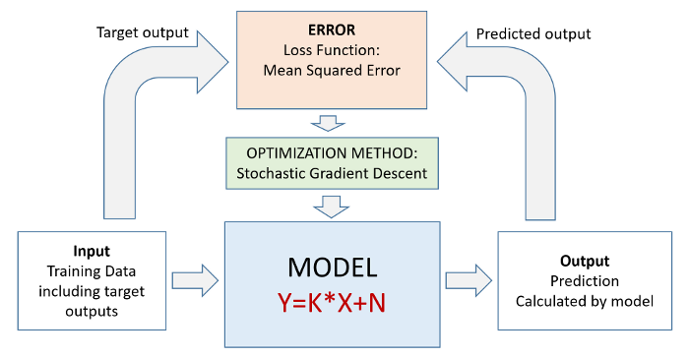
A machine learning training process
*https://in.pinterest.com/pin/684758318328612307/

Slide 4
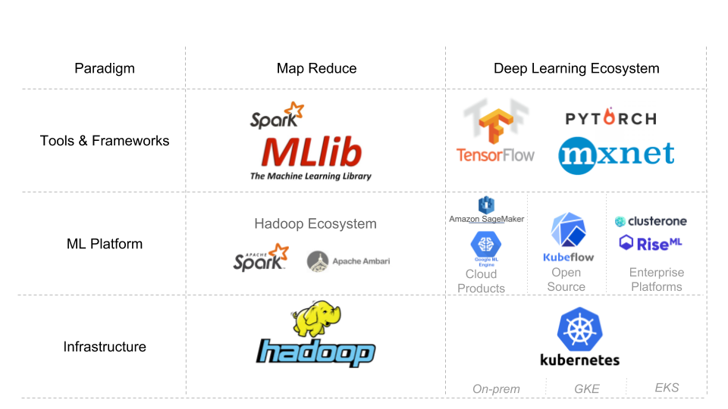
Machine Learning vs Deep Learning

Slide 5

A DeepLearning Hello World: handwritten digits classification
?
0
0
0
0
0
0
0
0
1
0
0
1
8
9
28*28 pixels
10*1 one-hot vector
MNIST = Mixed National Institute of Standards and Technology
Download the dataset at http://yann.lecun.com/exdb/mnist/

Slide 6
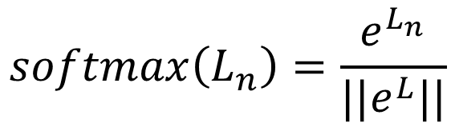
Simple model: softmax classification
784 pixels
$$h\left(x\right)=softmax(X.W+b)$$
28x28
pixels
...
where
...
$$softmax\left(L_{n}\right)=\frac{e^{L_{n}}}{||e^{L}||}$$
softmax
0
1
2
9

Slide 7



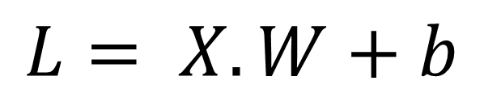


For efficiency, 100 images at a time
10 columns
^{w}0,0 ^{w}1,0 ^{w}2,0 ^{w}3,0 ^{w}4,0 ^{w}5,0 ^{w}6,0 ^{w}7,0 ^{w}8,0
^{w}0,1 ^{w}1,1 ^{w}2,1 ^{w}3,1 ^{w}4,1 ^{w}5,1 ^{w}6,1 ^{w}7,1 ^{w}8,1
^{w}0,2 ^{w}1,2 ^{w}2,2 ^{w}3,2 ^{w}4,2 ^{w}5,2 ^{w}6,2 ^{w}7,2 ^{w}8,2
^{w}0,3 ^{w}1,3 ^{w}2,3 ^{w}3,3 ^{w}4,3 ^{w}5,3 ^{w}6,3 ^{w}7,3 ^{w}8,3
^{… w}0,9
^{… w}1,9
^{… w}2,9
^{… w}3,9
^{… w}4,9
^{… w}5,9
^{… w}6,9
^{… w}7,9
^{… w}8,9
$$W$$
784 lines
x
x
x
$$L= X.W+b$$
X : 100 images, one per line, flattened
x
x
x
x
…
x
^{w}783,0 ^{w}783,1 ^{w}783,2
^{… w}783,9
^{L}0,0 ^{L}0,1 ^{L}0,2 ^{L}0,3 ^{L}1,0 ^{L}1,1 ^{L}1,2 ^{L}1,3 ^{L}2,0 ^{L}2,1 ^{L}2,2 ^{L}2,3 ^{L}3,0 ^{L}3,1 ^{L}3,2 ^{L}3,3 ^{L}4,0 ^{L}4,1 ^{L}4,2 ^{L}4,3
…
^{L}99,0 ^{L}99,1 ^{L}99,2
……L_{0,9}
^{… L}1,9
^{… L}2,9
^{… L}3,9
^{… L}4,9
^{… L}99,9
+
b₀ b₁ b₂ b₃ … b₉
$$X$$
$$b$$
+ Same biases on all lines

Slide 8
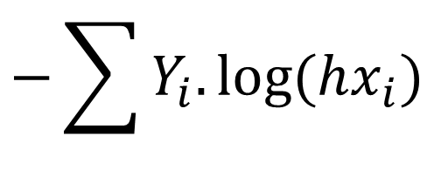
Loss function
0 | 1 | 2 | 3 | 4 | 5 | 6 | 7 | 8 | 9
0 | 0 | 0 | 0 | 0 | 0 | 1 | 0 | 0 | 0
Cross entropy:
computed probabilities
actual probabilities, “one-hot” encoded
$$−\sum{Y_{i}.log⁡(hx_{i})}$$
this is a “6”
0.1 | 0.2 | 0.1 | 0.3 | 0.2 | 0.1 | 0.9 | 0.2 | 0.1 | 0.1
0 | 1 | 2 | 3 | 4 | 5 | 6 | 7 | 8 | 9

Slide 9
Training process (pseudo code)
for iteration in range(1:100):
for batch in mini_batches:
x, y = batch.input, batch.label
hx = softmax(Wx + b)
loss = sum(y * log(hx))
gradw = grad(loss, W)
gradb = grad(loss, b)
W += gradw * alpha
b += gradb * alpha
784 pixels
28x28
pixels
...
softmax
...
0
1
2
9

Slide 10
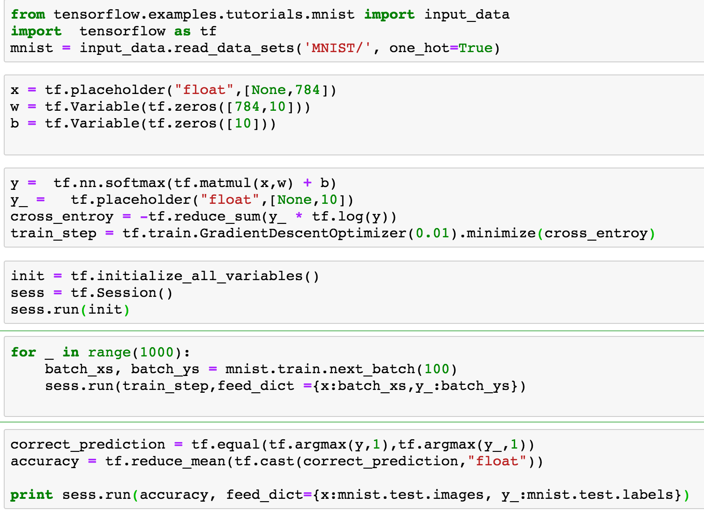
A tensorflow softmax program

Slide 11
Phases of Tensorflow Programs
Phase 1
Build a computation graph(Neural Network)
At this phase, no real calculation operations are triggered
Phase 2
Compute
Usually triggered by run()
X
W
Y
*
dot
b
+
reduce_sum
softmax
minus
log
cross_entropy

Slide 12
Are there better ways to write neural Network?
Writing Tensorflow applications is like writing mathematics formula
Use placeholders and variables to represent the function
Neural network layers are presented by matrix multiplication
Specify cost function and optimizer
It is powerful, but require more programming efforts

Slide 13
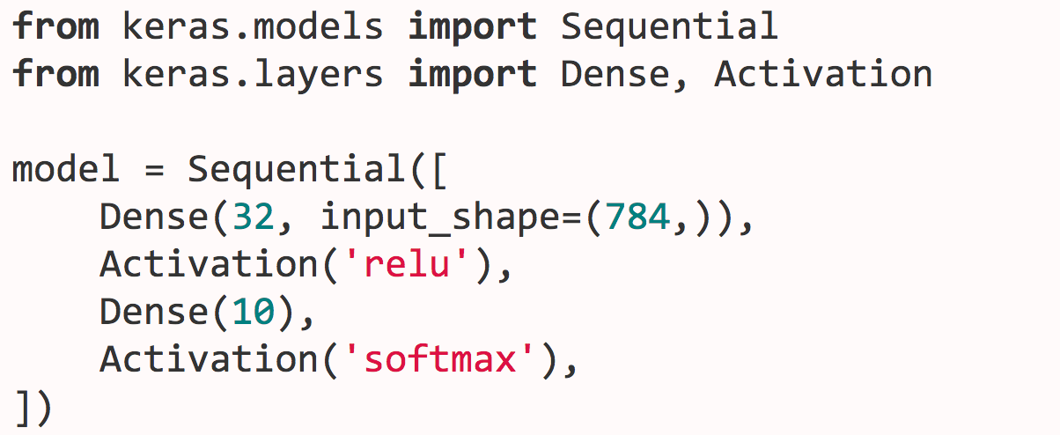
Keras
A layer based abstraction for Neural Networks
Higher level abstractions, less flexible

Slide 14
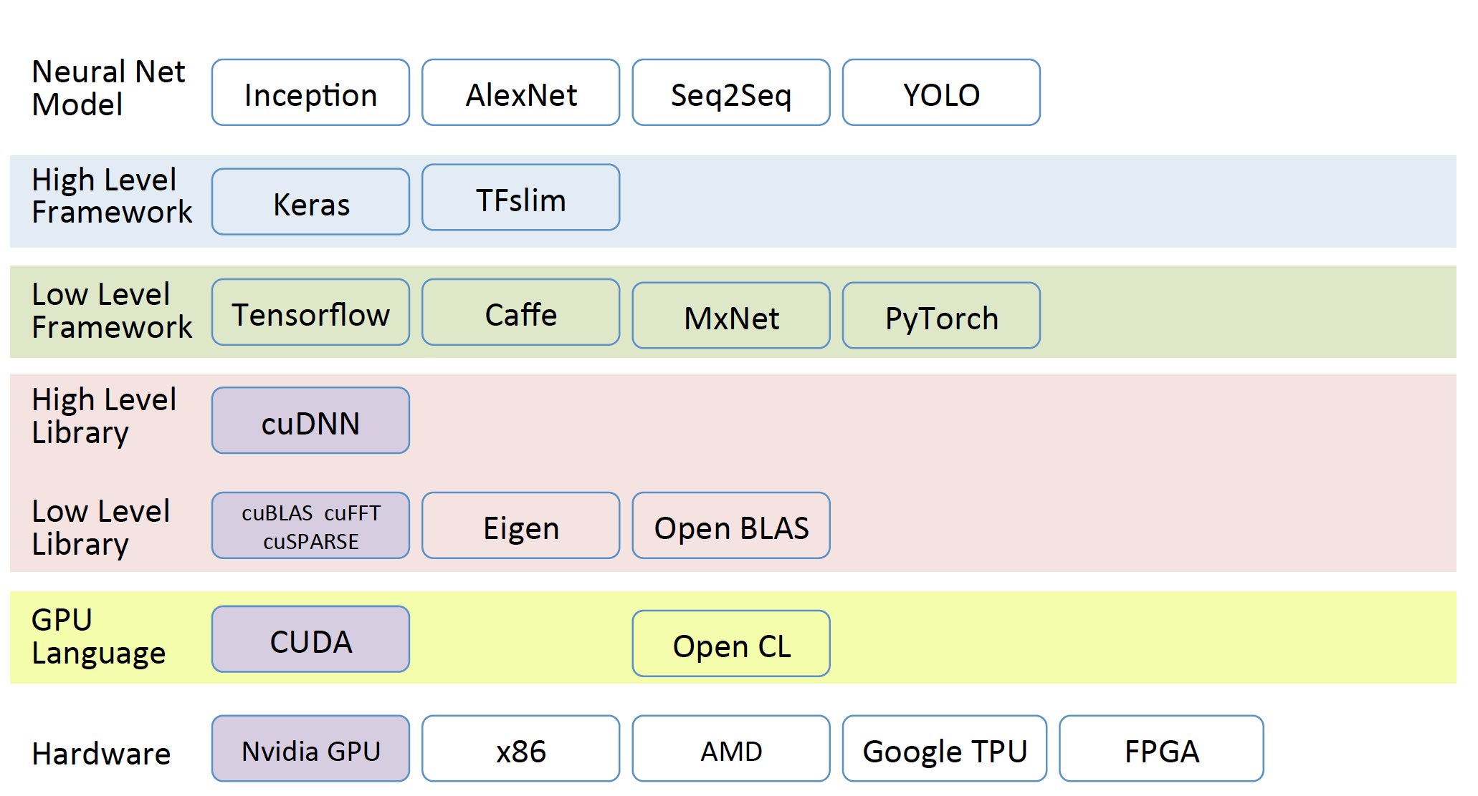
Deep Learning Abstraction Levels

Slide 15
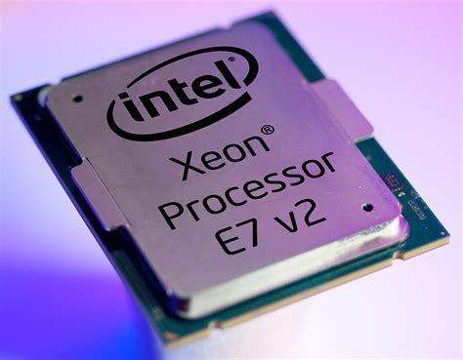
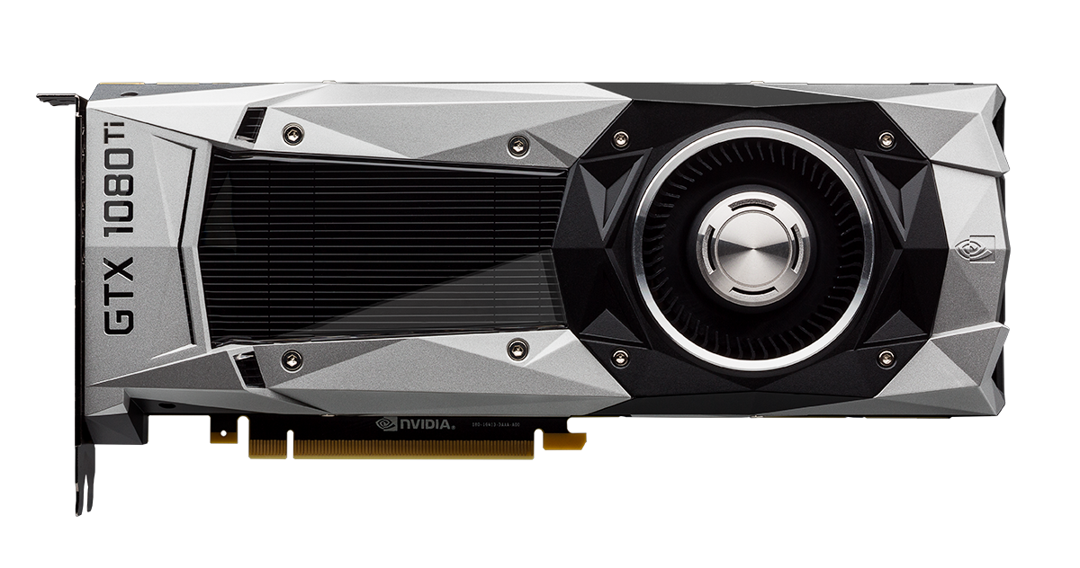
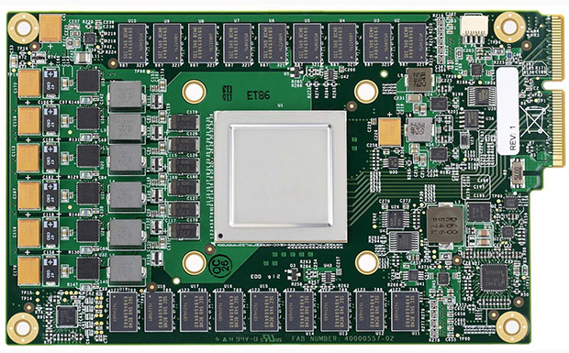
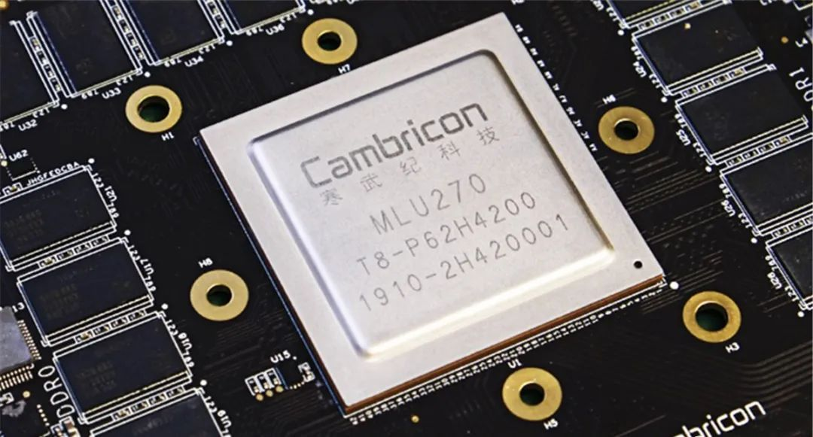
Processors with different architectures
Nvidia GPU
X86
Google TPU
Cambricon AI accelerators

Slide 16
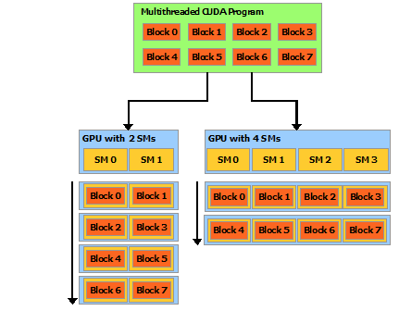
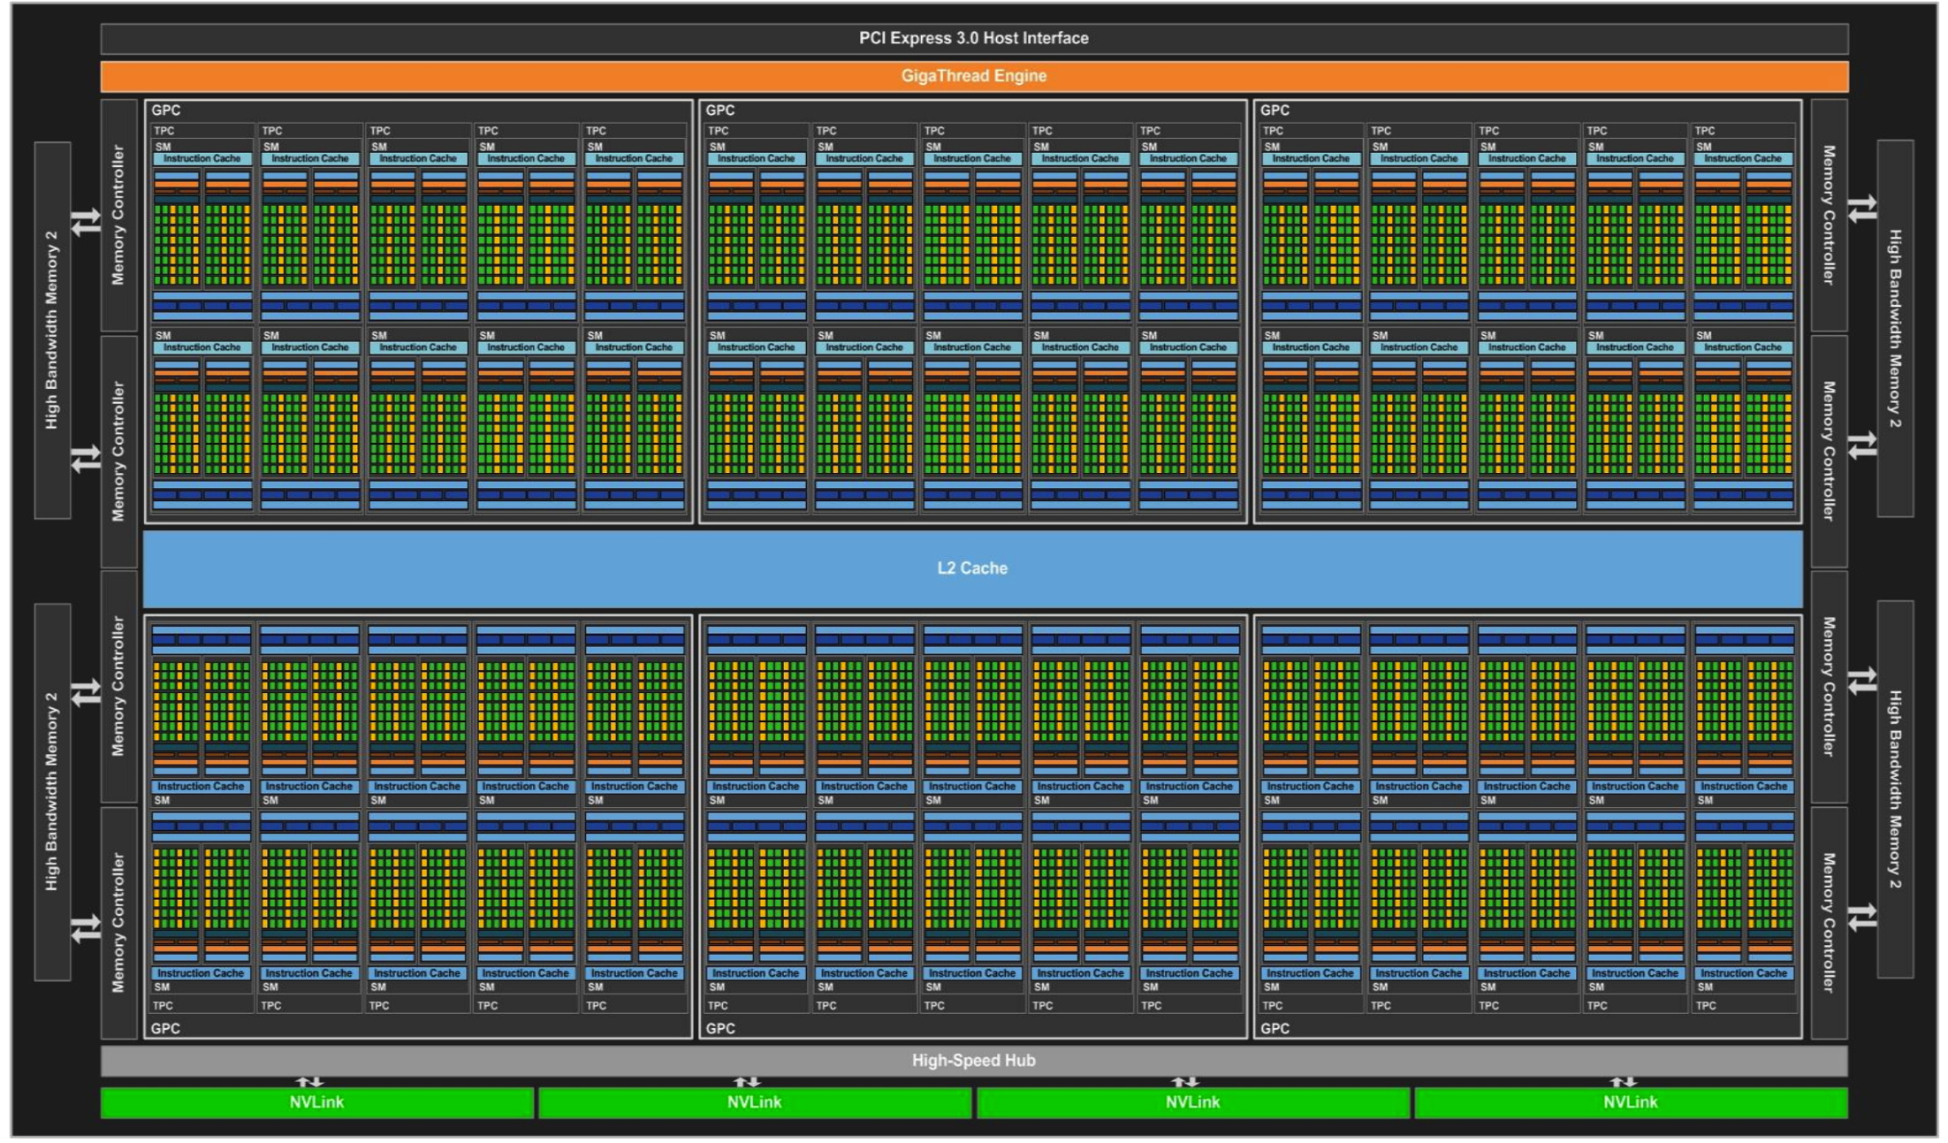
GPU
Massively parallel threads
Register/Shared memory, global memory
CUDA provides general programming interfaces

Slide 17
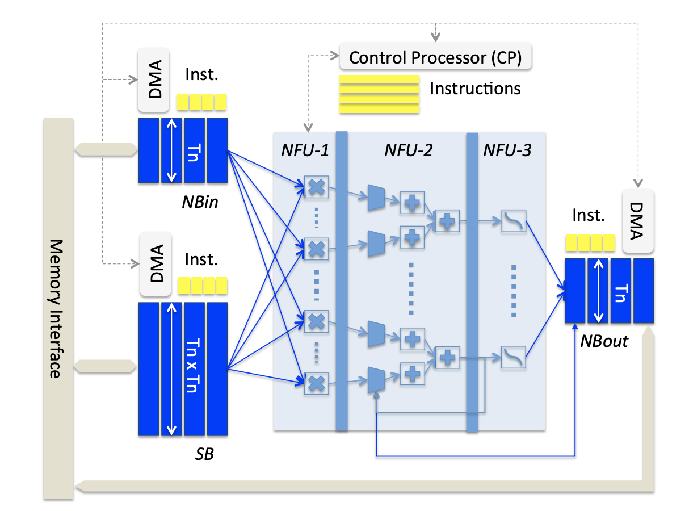
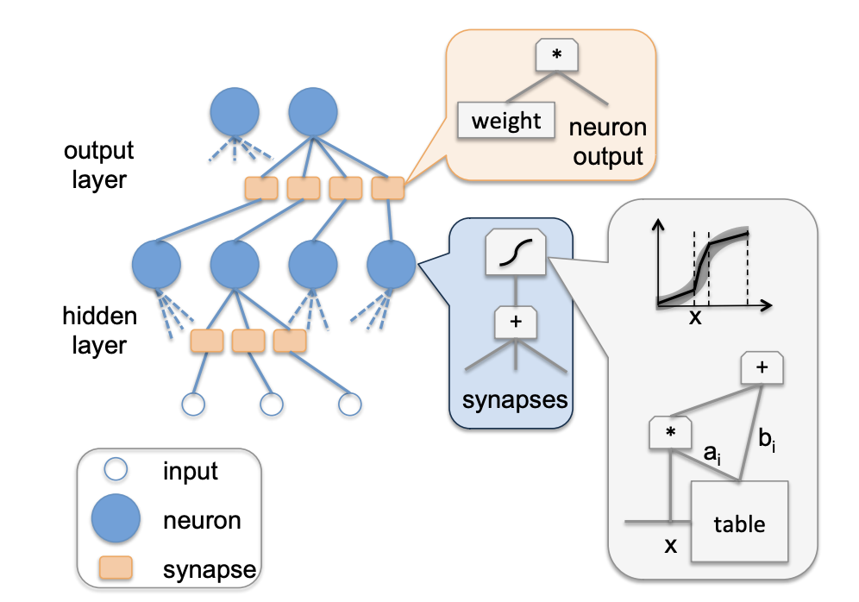
Diannao
NN optimized architecture
Chen, Yunji, et al. "DianNao family: energy-efficient hardware accelerators for machine learning." Communications of the ACM 59.11 (2016): 105-112.

Slide 18
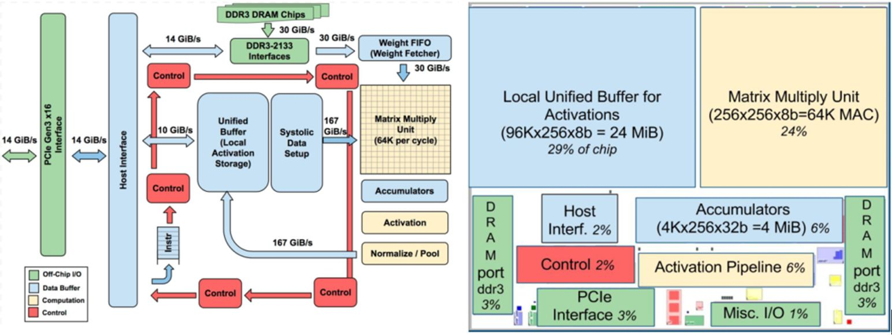
Google TPU
Dataflow architecture
Matrix Units
Weight FIFO for machine learning
Programming with Tensorflow

Slide 19
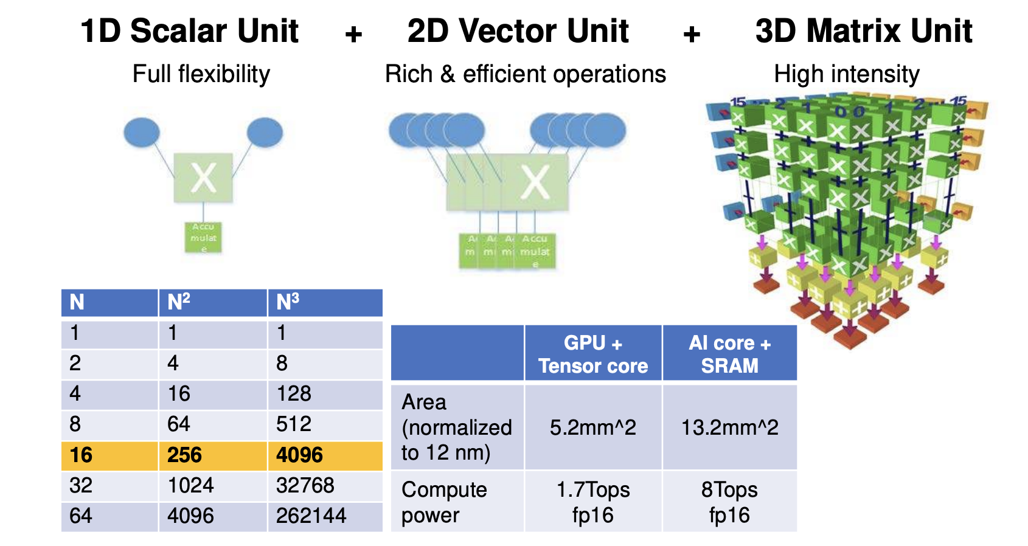
Huawei Davinci
Dataflow architecture
Cube Units

Slide 20
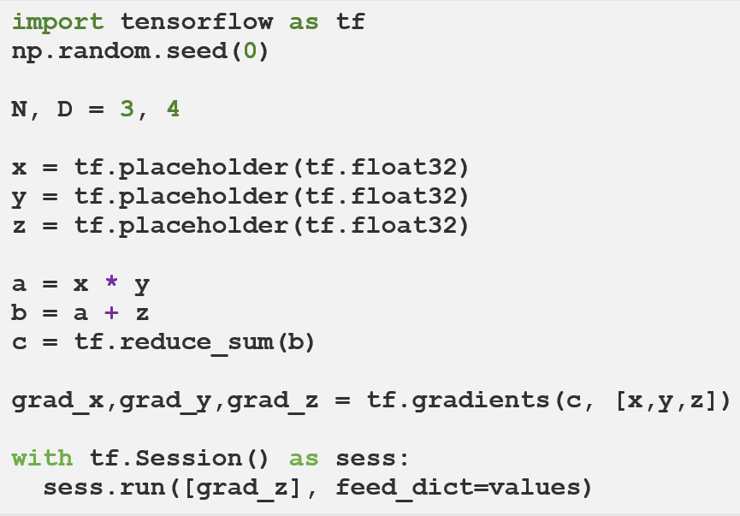




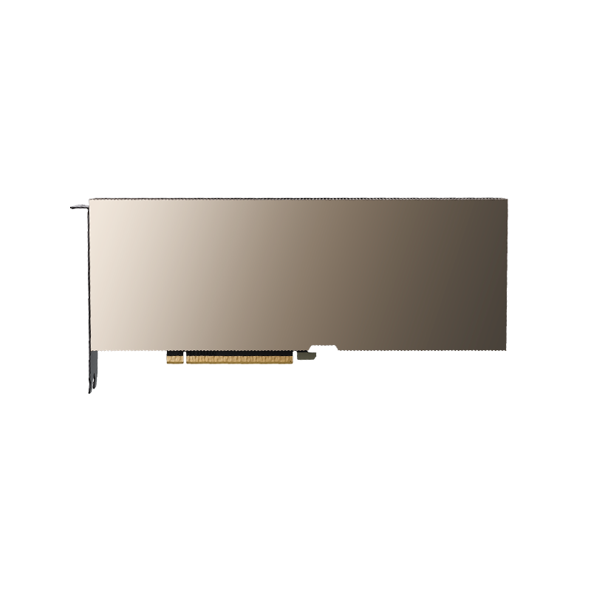
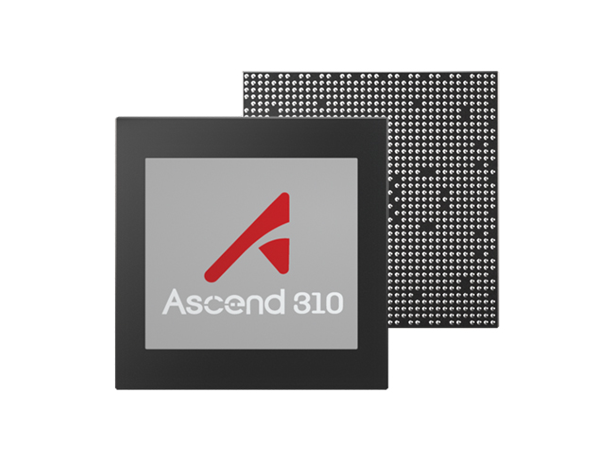



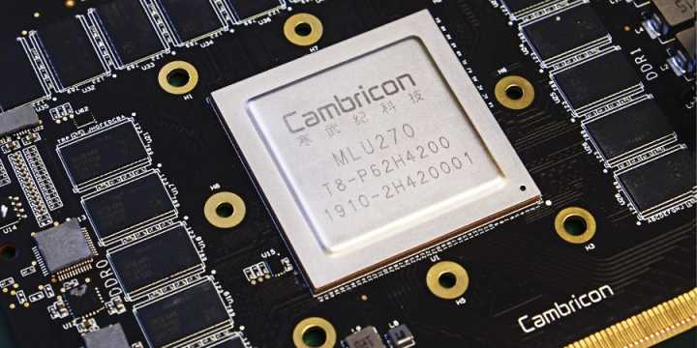
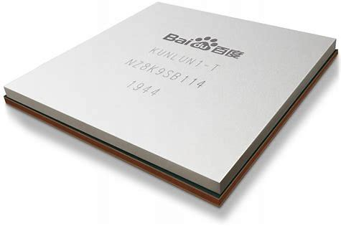
Machine Learning Systems
Compile the program to flowgraph and optimize it
Support libraries for new hardware
Thousands of operators which are not affordable to be implemented manually
code
Flowgraph
Operator library
AI processors
Graph Opt.
(Arch Indep.)
Operator Opt.
(Arch Dep.)

Slide 21
Library Implementation

Slide 22
Why implement a fast operator is challenging
Everyone can write matrix multiplication, but very few can do it efficiently…
c = (double *) calloc(sizeof(double), n*n);
/* Multiply n x n matrices a and b */
void mmm(double *a, double *b, double *c, int n) {
int i, j, k;
for (i = 0; i < n; i++)
for (j = 0; j < n; j++)
for (k = 0; k < n; k++)
c[i*n + j] += a[i*n + k] * b[k*n + j];
}

Slide 23
Example: Matrix Multiplication
c = (double *) calloc(sizeof(double), n*n);
/* Multiply n x n matrices a and b */
void mmm(double *a, double *b, double *c, int n) {
int i, j, k;
for (i = 0; i < n; i++)
for (j = 0; j < n; j++)
for (k = 0; k < n; k++)
c[i*n + j] += a[i*n + k] * b[k*n + j];
}
j
c
a
b
=
*
i

Slide 24
Matrix Multiplication Loop Orders
ijk (& jik):
2 loads, 0 stores
misses/iter = 1.25
kij (& ikj):
2 loads, 1 store
misses/iter = 0.5
jki (& kji):
2 loads, 1 store
misses/iter = 2.0
for (i=0; i<n; i++) {
for (j=0; j<n; j++) {
sum = 0.0;
for (k=0; k<n; k++)
sum += a[i][k] * b[k][j];
c[i][j] = sum;
}
}
for (k=0; k<n; k++) {
for (i=0; i<n; i++) {
r = a[i][k];
for (j=0; j<n; j++)
c[i][j] += r * b[k][j];
}
}
for (j=0; j<n; j++) {
for (k=0; k<n; k++) {
r = b[k][j];
for (i=0; i<n; i++)
c[i][j] += a[i][k] * r;
}
}

Slide 25
Blocked Matrix Multiply (bijk)
for (jj=0; jj<n; jj+=bsize) {
for (i=0; i<n; i++)
for (j=jj; j < min(jj+bsize,n); j++)
c[i][j] = 0.0;
for (kk=0; kk<n; kk+=bsize) {
for (i=0; i<n; i++) {
for (j=jj; j < min(jj+bsize,n); j++) {
sum = 0.0
for (k=kk; k < min(kk+bsize,n); k++) {
sum += a[i][k] * b[k][j];
}
c[i][j] += sum;
}
}
}
}

Slide 26
Blocked Matrix Multiply Analysis
Innermost loop pair multiplies a 1 X bsize sliver of A by a bsize X bsize block of B and accumulates into 1 X bsize sliver of C
Loop over i steps through n row slivers of A & C, using same B
for (i=0; i<n; i++) {
for (j=jj; j < min(jj+bsize,n); j++) {
sum = 0.0
for (k=kk; k < min(kk+bsize,n); k++) {
sum += a[i][k] * b[k][j];
}
c[i][j] += sum;
}
Innermost
Loop Pair
kk
jj
jj
kk
i
i
A
B
C
row sliver accessed
bsize times
Update successive
elements of sliver
block reused n times in succession

Slide 27
Blocked Matrix Multiplication
c = (double *) calloc(sizeof(double), n*n);
/* Multiply n x n matrices a and b */
void mmm(double *a, double *b, double *c, int n) {
int i, j, k;
for (i = 0; i < n; i+=B)
for (j = 0; j < n; j+=B)
for (k = 0; k < n; k+=B)
/* B x B mini matrix multiplications */
for (i1 = i; i1 < i+B; i++)
for (j1 = j; j1 < j+B; j++)
for (k1 = k; k1 < k+B; k++)
c[i1*n+j1] += a[i1*n + k1]*b[k1*n + j1];
}
matmult/bmm.c
j1
c
a
b
c
=
*
+
i1
Block size B x B
Notes:
How large is B? what happens if the matrix is not square matrix

Slide 28
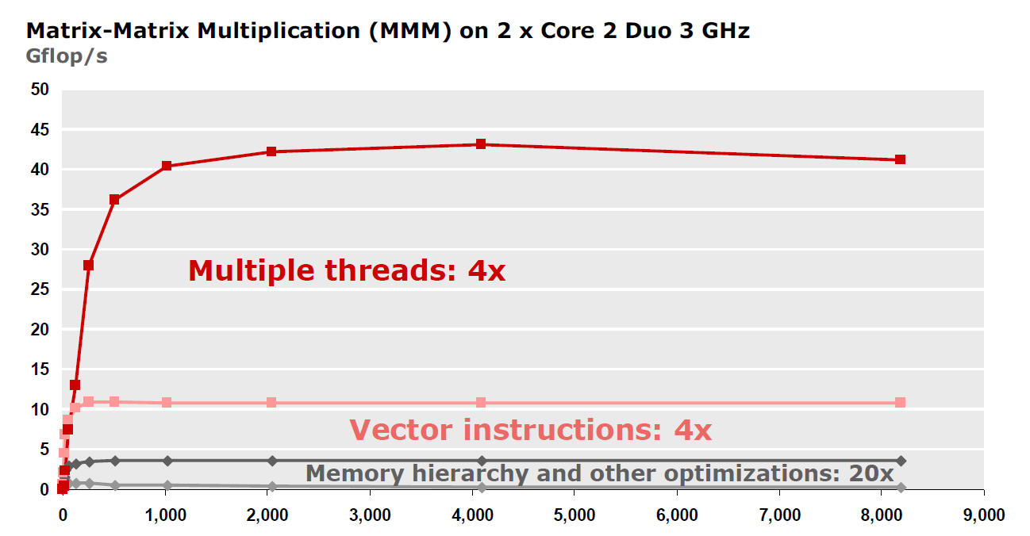
MMM Analysis
Reason for 20x: Blocking or tiling, loop unrolling, array scalarization, instruction scheduling, search to find best choice
Effect: less register spills, less L1/L2 cache misses, less TLB misses

Slide 29
Running matrix operations efficiently
Fortunately, many matrix operations are standard:
Matrix-matrix multiplication, matrix-vector multiplication, matrix addition, matrix-vector addition, …
MKL, OpenBLAS, cuBLAS, …
And you can access these libraries with python
numpy
Notes:
numpy

Slide 30
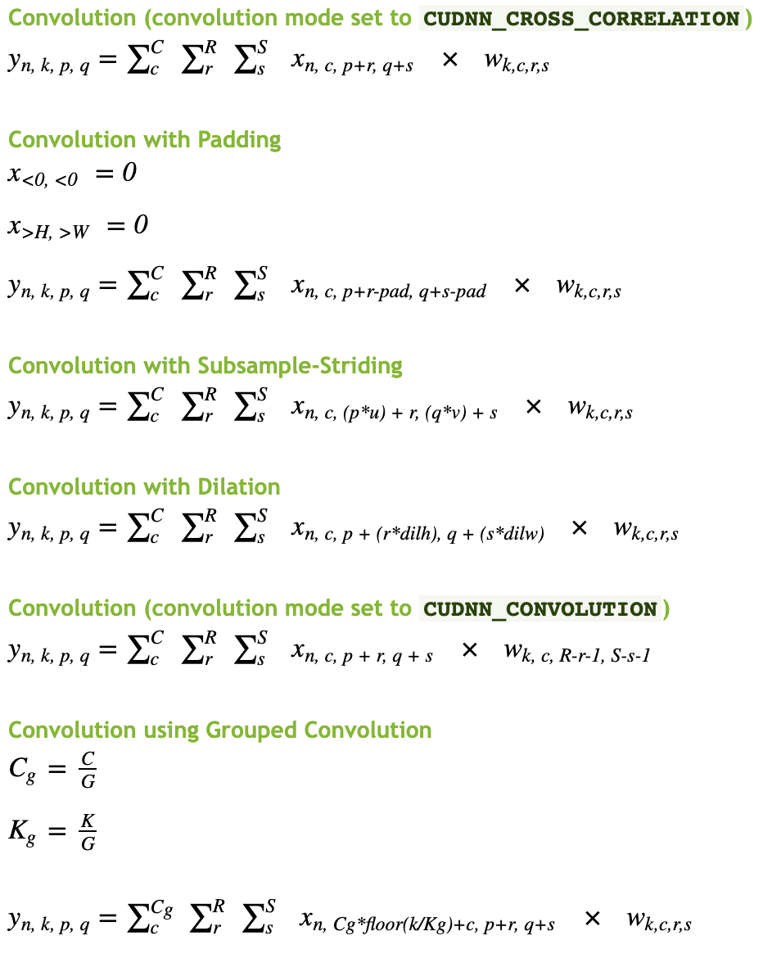
However, deep learning requires many more operators
Many variations of operations
Padding
Sampling
Grouped
…
It is prohibitive to write all operators manually

Slide 31
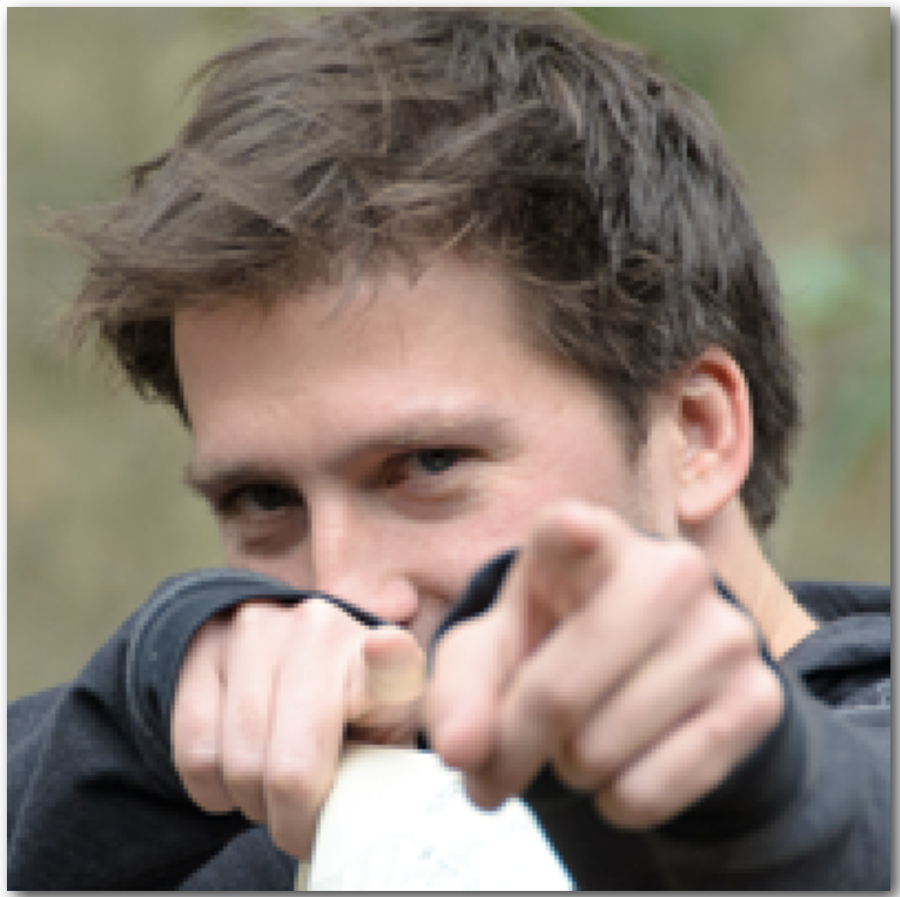


Sample:3$×$3 Blur

Slide 32


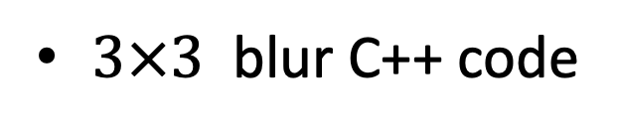
Blur as another example
$3×3$ blur C++ code
void box_filter_3x3(const Image &in, Image &blury) {
Image blurx(in.width(), in.height());
for (int y = 0; y < in.height(); y++)
for (int x = 0; x < in.width(); x++)
blurx(x, y) =(in(x-1, y) + in(x, y) + in(x+1, y)) / 3;
for (int y = 0; y < in.height(); y++)
for (int x = 0; x < in.width(); x++)
blury(x, y) =(blury(x, y-1) + blurx(x, y) + blury(x, y+1))/3;
}
Ref: https://halide-lang.org/assets/lectures/Halide_CVPR_intro.pdf

Slide 33
Optimized C++ code
void box_filter_3x3(const Image &in, Image &blury) {
__m128i one_third = _mm_set1_epi16(21846);
#pragma omp parallel for
for (int yTile = 0; yTile < in.height(); yTile += 32) {
__m128i a, b, c, sum, avg;
__m128i blurx[(256/8)*(32+2)];
for (int xTile = 0; xTile < in.width(); xTile += 256) {
__m128i *blurxPtr = blurx;
for (int y = -­1; y < 32+1; y++) {
const uint16_t *inPtr = &(in[yTile+y][xTile]);
for (int x = 0; x < 256; x += 8) {
a = _mm_loadu_si128(( m128i*)(inPtr-1));
b = _mm_loadu_si128(( m128i*)(inPtr+1));
c = _mm_load_si128(( m128i*)(inPtr));
sum = _mm_add_epi16(_mm_add_epi16(a, b), c);
avg = _mm_mulhi_epi16(sum, one_third);
_mm_store_si128(blurxPtr++, avg);
inPtr += 8;
}}
blurxPtr = blurx;
for (int y = 0; y < 32; y++) {
__m128i *outPtr = (__m128i*)(&(blury[yTile+y][xTile]));
for (int x = 0; x < 256; x += 8) {
a = _mm_load_si128(blurxPtr+(2*256)/8);
b = _mm_load_si128(blurxPtr+256/8);
c = _mm_load_si128(blurxPtr++);
sum = _mm_add_epi16(_mm_add_epi16(a, b), c);
avg = _mm_mulhi_epi16(sum, one_third);
_mm_store_si128(outPtr++, avg);
}}}}}
Optimization
Parallellizaiton: OpenMP
Tiling
SIMD Vectorization
Loop fusion
Performance
9.9 s/mpixel → 0.9 s/M pixel

Slide 34
Who can write this code?
void box_filter_3x3(const Image &in, Image &blury) {
__m128i one_third = _mm_set1_epi16(21846);
#pragma omp parallel for
for (int yTile = 0; yTile < in.height(); yTile += 32) {
__m128i a, b, c, sum, avg;
__m128i blurx[(256/8)*(32+2)];
for (int xTile = 0; xTile < in.width(); xTile += 256) {
__m128i *blurxPtr = blurx;
for (int y = -­1; y < 32+1; y++) {
const uint16_t *inPtr = &(in[yTile+y][xTile]);
for (int x = 0; x < 256; x += 8) {
a = _mm_loadu_si128(( m128i*)(inPtr-1));
b = _mm_loadu_si128(( m128i*)(inPtr+1));
c = _mm_load_si128(( m128i*)(inPtr));
sum = _mm_add_epi16(_mm_add_epi16(a, b), c);
avg = _mm_mulhi_epi16(sum, one_third);
_mm_store_si128(blurxPtr++, avg);
inPtr += 8;
}}
blurxPtr = blurx;
for (int y = 0; y < 32; y++) {
__m128i *outPtr = (__m128i*)(&(blury[yTile+y][xTile]));
for (int x = 0; x < 256; x += 8) {
a = _mm_load_si128(blurxPtr+(2*256)/8);
b = _mm_load_si128(blurxPtr+256/8);
c = _mm_load_si128(blurxPtr++);
sum = _mm_add_epi16(_mm_add_epi16(a, b), c);
avg = _mm_mulhi_epi16(sum, one_third);
_mm_store_si128(outPtr++, avg);
}}}}}
Optimization
Parallellizaiton: OpenMP
Tiling
SIMD Vectorization
Loop fusion
Performance
9.9 s/mpixel → 0.9 s/M pixel
It is extremely hard for programmers to write these code
Also hard to maintain
Is it possible to decouple the algorithm and optimization?

Slide 35
Halide Blur: 0.9s / M pixels
Func halide_blur(Func in) {
Func tmp, blurred;
Var x, y, xi, yi;
// Algorithm
tmp(x, y) = (in(x-1, y) + in(x, y) + in(x+1, y)) / 3;
blurred(x, y) = (tmp(x, y-1) + tmp(x, y) + tmp(x, y+1)) / 3;
// Scheduling(optimization)
blurred.tile(x, y, xi, yi, 256, 32)
.vectorize(xi, 8).parallel(y);
tmp.chunk(x).vectorize(x, 8);
return blurred;
}
Program = algorithm + scheduling
Ref: https://www.slideshare.net/kobe38/halide-1

Slide 36
Halide
Halide is a domain specific language
It decoupled the optimized implementation
Enables programmers with different skills to collaborate
Algorithm experts and system experts
Compilers are used to generate the parallel and optimized code
Originally designed for image processing,
Now used by AI compilers for AI operator generation
Program = algorithm + scheduling

Slide 37
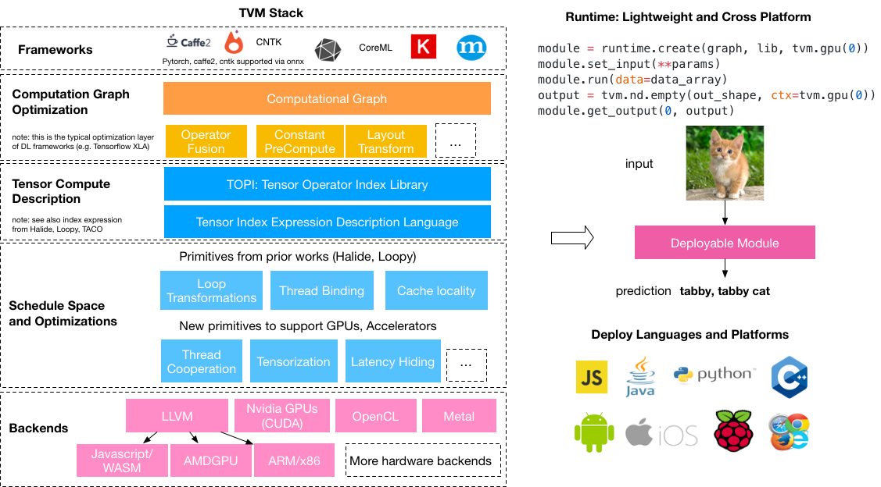
TVM the AI compiler

Slide 38
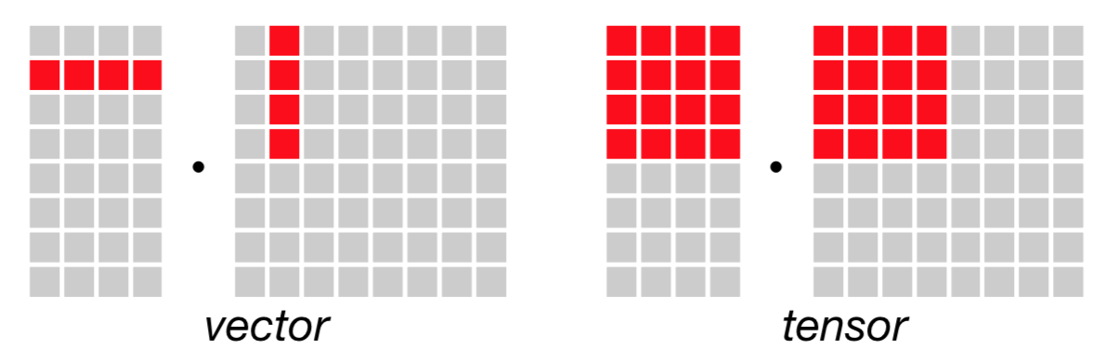
Tensor-based abstraction
Tensors are high dimensional arrays
Dense and sparse
Operations on tensors
Vector, matrix and tensor

Slide 39
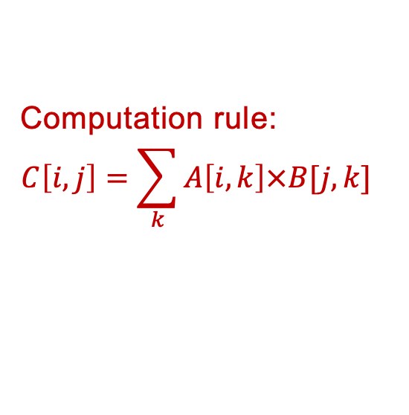
Tensor-based abstraction
C = matrix_multiply(A, B.T)
m, n, h = tvm.var('m'), tvm.var('n'), tvm.var('h')
A = tvm.placeholder((m, h), name='A')
B = tvm.placeholder((n, h), name='B')
k = tvm.reduce_axis((0, h), name='k')
C = tvm.compute((m, n),
lambda i, j: tvm.sum(A[i, k] * B[j, k], axis=k)
)
Input
Computation rule:
$$C\left[i,j\right]=\sum_{k}{A\left[i,k\right]×B[j,k] }$$
Output matrix shape

Slide 40
More tensor expressions
Affine transformations
Convolution
ReLU
out = tvm.compute((n,m), lambda i, j: tvm.sum(data[i,k] * w[j,k], k))
out = tvm.compute((n,m), lambda i, j: out[i,j] + bias[i])
out = tvm.compute((c, h, w),
lambda i, x, y: tvm.sum(data[kc,x+kx,y+ky] * w[i,kx,ky], [kx,ky,kc]))
out = tvm.compute(shape, lambda *i: tvm.max(0, out(*i)))

Slide 41
Scheduling example
C = tvm.compute((n, ), lambda i: A[i] + B[i])
s = tvm.create_schedule(C.op)
for (int i = 0; i < n; i++) {
C[i] = A[i] + B[i]
}

Slide 42
Scheduling example
C = tvm.compute((n, ), lambda i: A[i] + B[i])
s = tvm.create_schedule(C.op)
xo, xi = s[C].split(s[C].axis[0], factor=32)
for (int xo = 0; xo < ceil(n / 32); ++xo) {
for (int xi = 0; xi < 32; ++xi) {
int i = xo * 32 + xi;
if (i < n) {
C[i] = A[i] + B[i];
}
}
}

Slide 43
Scheduling example
C = tvm.compute((n, ), lambda i: A[i] + B[i])
s = tvm.create_schedule(C.op)
xo, xi = s[C].split(s[C].axis[0], factor=32)
s[C].reorder(xi, xo)
for (int xi = 0; xi < 32; ++xi) {
for (int xo = 0; xo < ceil(n / 32); ++xo) {
int i = xo * 32 + xi;
if (i < n) {
C[i] = A[i] + B[i];
}
}
}
Notes:
交换顺序，多个循环合并有用

Slide 44
Scheduling example
C = tvm.compute((n, ), lambda i: A[i] + B[i])
s = tvm.create_schedule(C.op)
xo, xi = s[C].split(s[C].axis[0], factor=32)
s[C].reorder(xi, xo)
s[C].bind(xo, tvm.thread_axis("blockIdx.x"))
s[C].bind(xi, tvm.thread_axis("threadIdx.x"))
int i = threadIdx.x * 32 + blockIdx.x;
if (i < n) {
C[i] = A[i] + B[i];
}
Generate CUDA code

Slide 45
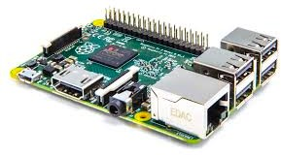

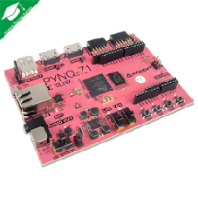

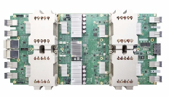
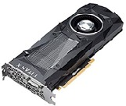
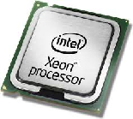
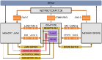
Scheduling Primitives in TVM
Tensor expressions
Halide primitives
Loop transformation
Thread Binding
Cache Locality
New primitives in TVM
(for GPU)
Thread Cooperation
Latency Hiding
…
Tensorization
Hardware

Slide 46
Automatic Scheduling Generation
Execution
Optimizer
Code generator
Time measurement
Large overhead, each testing may take 1s for simple operators

Slide 47
Scheduling space explosion
Tensor expression
C = t.compute((m, n),
lambda i, j: t.sum(A[i, k] * B[j, k], axis=k))
Schedule 1
Schedule 2
Schedule 3
….
Executable 1
Executable 2
Executable 3
….

Slide 48
Machine learning based optimizer
Optimizer
Executable
Code Generator
Training
Peformance model
Performance data
The machine learning model predict the performance within 1ms

Slide 49
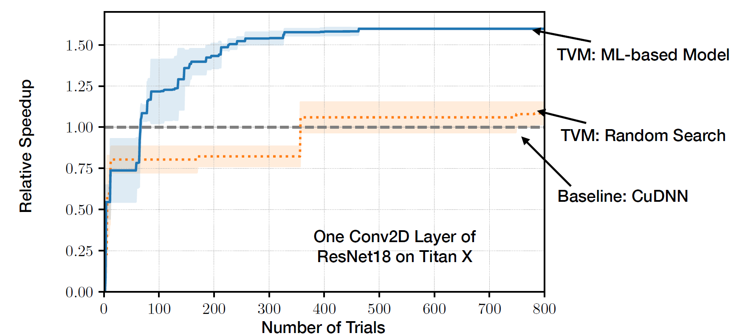
ML-based scheduling search

Slide 50
Graph Optimization

Slide 51
Graph presentation of AI programs
Graphs are constructed with operators and tensors
Input
Operators including
Linear:conv matmul Non-linear: relu, sigmoid
conv3x3
conv1x1
relu
relu
conv3x3
tensors
add
relu
51
Notes:
Machine learning computation is typically defined as tensor programs represented in graph structures. Each node in the graph denotes a linear algebra operator such as convolution or a non-linear activation function such as ReLU. Each edge is a tensor , an n-dimensional array, shared between operators.

Slide 52
Transformation of Graphs
Input
Fuse conv + relu
Input
conv
conv
conv
conv
+ relu
conv3x3
+ relu
conv1x1
+ relu
relu
relu
relu
conv3x3
Fuse convs
conv
conv
conv
add
add
add
add
conv
relu
relu
…
Input Graph
Optimized graph
Transformation
52
Notes:
To optimize the performance of a tensor program, existing frameworks use program transformations to iteratively optimize the graph structure of an input program to obtain an optimized program.

Slide 53
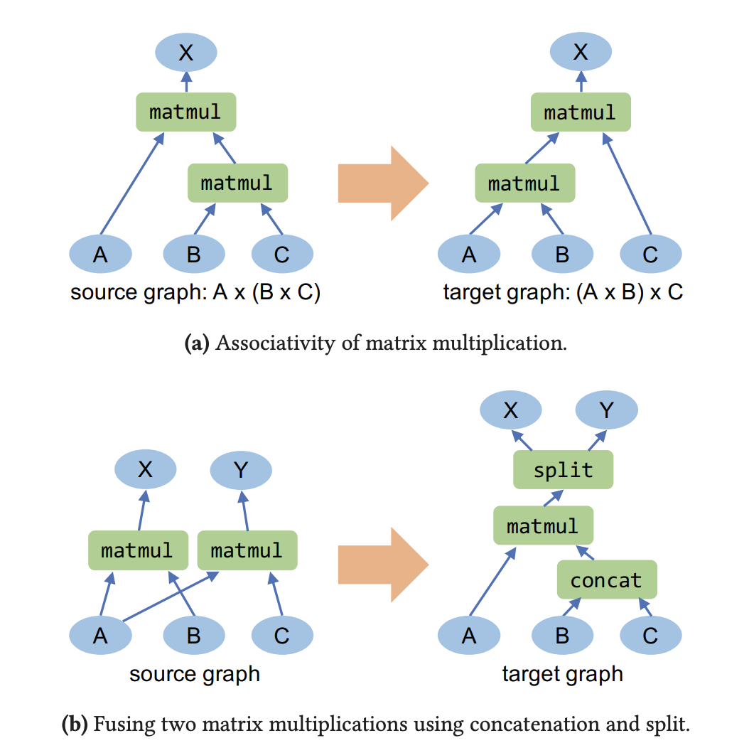
Huge transformation space

Slide 54
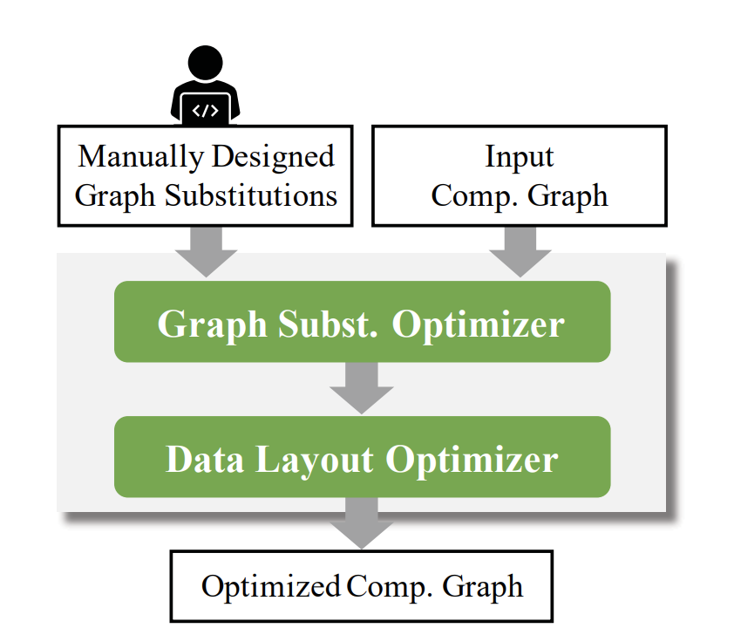
Manually Designed Graph subst.
Most AI Compilers(TensorFlow, PyTorch, TensorRT and TVM) adopt his approach
Programmers design transformation rules
Maintainability: TensorFlow r1.14 includes 155 substitutions implemented in approximately 53K lines of C++ code
Correctness: Human written rules are error prone
Uses greedy search algorithm

Slide 55
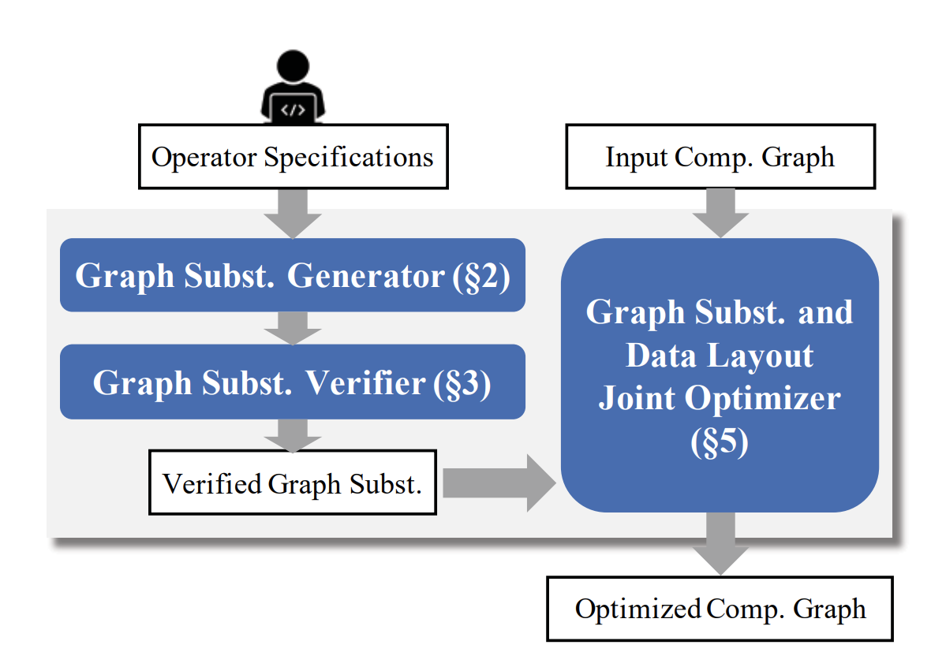
Generate and Verify Graph Transformation Automatically
TASO*
*Jia, Zhihao, et al. "TASO: optimizing deep learning computation with automatic generation of graph substitutions." Proceedings of the 27th ACM Symposium on Operating Systems Principles. 2019.

Slide 56

Full Equivalence
$$∀p. Y[p]=Z[p]$$
Transformations are only valid if they are fully equivalent
56
Notes:
Existing systems consider only fully equivalent transformations. The left figure shows an example. In a fully equivalent transformation, the two programs always produce the exact same result for arbitrary output position. An advantage of fully equivalent transformations is preserving functionality, and we don’t need to worry about model accuracy loss when performing transformations. A drawback is that we will miss optimization opportunities where fully equivalence is not preserved and achieve suboptimal performance.
On the other hand, the tensor program optimization space contains a spectrum of partially equivalent transformations, where the two programs may produce different results for some output positions. Partially equivalent transformations may lead to better runtime performance by using faster ML operators, more efficient tensor layouts, and other systems optimizations. But these transformations may change the functionality of a network and result in potential model accuracy loss. This is also why existing DNN systems consider only fully equivalent transformations.

Slide 57


Partial Equivalence
$$∀p. Y[p]=Z[p]$$
$$∃p. Y[p]≠Z[p]$$
Is it possible to use the partial equivalent transformation?
57
Notes:
Existing systems consider only fully equivalent transformations. The left figure shows an example. In a fully equivalent transformation, the two programs always produce the exact same result for arbitrary output position. An advantage of fully equivalent transformations is preserving functionality, and we don’t need to worry about model accuracy loss when performing transformations. A drawback is that we will miss optimization opportunities where fully equivalence is not preserved and achieve suboptimal performance.
On the other hand, the tensor program optimization space contains a spectrum of partially equivalent transformations, where the two programs may produce different results for some output positions. Partially equivalent transformations may lead to better runtime performance by using faster ML operators, more efficient tensor layouts, and other systems optimizations. But these transformations may change the functionality of a network and result in potential model accuracy loss. This is also why existing DNN systems consider only fully equivalent transformations.

Slide 58

Motivation for Partial Equivalence
Original program
Correction
Incorrect positions
Partially equivalent transformation
20% performance improvement on Resnet-18
Wang, Haojie, et al. "{PET}: Optimizing Tensor Programs with Partially Equivalent Transformations and Automated Corrections." 15th USENIX Symposium on Operating Systems Design and Implementation (OSDI 21). 2021.
Notes:
Let’s take a look at a motivating example. The left graph shows an input program with a standard convolution operator. The middle graph shows a possible partially equivalent transformation, where we first concatenate two images into a single one along the width dimension, then perform a convolution operator and finally split the larger image to two separate images. This transformation improve the performance of convolution by enabling more parallelism within a image. But it also changes the semantics of convolution for pixels along the boundary of two images and produces incorrect results, shown as the red shadowed boxes. Finally, we can apply a correction operator afterward only on the incorrect pixels to recover correctness.

Slide 59
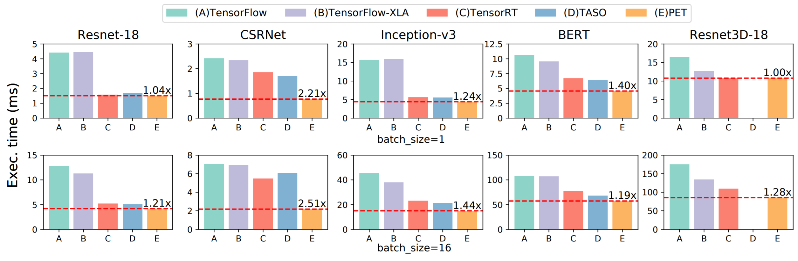
Performance Evaluation

Slide 60
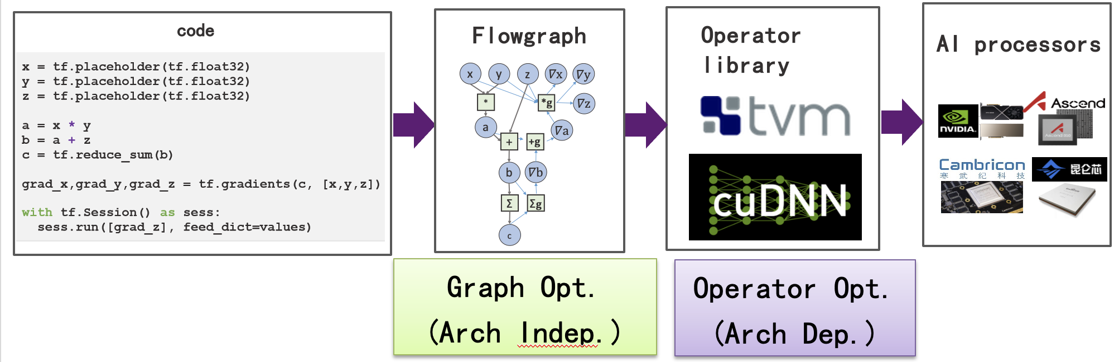
Summary
Deep Learning Systems uses high level abstractions and various hardware accelerators
Optimizations are performed on graph and operators
Auto-search is the major way to find optimized code in both
Operator library generation is still the major challenges to new hardware
TVM is good for CPU and GPUs, but not suitable for other AI proccesors
Even Huawei and Google are not capable to keep the pace with CuDNN
Trend to converge the optimization of graph and operators
We will discuss the distributed part of machine learning systems in the next lecture

Slide 61
Thanks

